Slide 1



EV Adoption Forecasting Model
Name : Arshad Pasha
College: Seshadripuram Degree College ,Mysore

Slide 2

Learning Objectives
• Master time series forecasting techniques for transportation data
• Apply machine learning regression models to real-world infrastructure challenges
• Understand data preprocessing for vehicle registration datasets
• Develop predictive models for sustainable transportation planning
• Learn to handle missing data and outliers in large datasets
• Gain insights into EV market trends and adoption patterns
GOAL
Source :
www.freepik.com/

Slide 3
Tools and Technology used
Programming Language: Python 3.x
Libraries & Frameworks:
• pandas - Data manipulation and analysis
• numpy - Numerical computations
• matplotlib & seaborn - Data visualization
• scikit-learn - Machine learning algorithms
• joblib - Model serialization
Machine Learning Models:
• Random Forest Regressor
• RandomizedSearchCV for hyperparameter tuning
Development Environment:
• Jupyter Notebook
• Ubuntu 24.04.2 LTS (Dev Container)
• Git version control

Slide 4
Methodology
1. DATA COLLECTION & EXPLORATION
- Washington State DOL vehicle registration data (2017-2024)
- 20,819 data points across 10 features
- County-wise EV distribution analysis
2. DATA PREPROCESSING
- DateTime conversion for temporal analysis
- Missing value imputation (County/State)
- Outlier detection using IQR method
- Feature engineering for time-based patterns
3. FEATURE ENGINEERING
- Label encoding for categorical variables
- Time-based feature extraction
- Regional clustering analysis
4. MODEL DEVELOPMENT
- Random Forest Regressor implementation
- Train-test split (80-20)
- Hyperparameter optimization
5. MODEL EVALUATION
- MAE, MSE, R² score metrics
- Cross-validation techniques
- Performance visualization

Slide 5
Problem Statement:
Challenge: Urban planners struggle to anticipate EV charging infrastructure needs
Impact: Inadequate planning leads to:
• Charging station bottlenecks
• Reduced user satisfaction
• Hindered sustainability goals
• Inefficient resource allocation
Question: How can we predict future EV adoption to optimize infrastructure planning?

Slide 6
Solution:
Developed a Machine Learning Forecasting System:
APPROACH:
• Analyzed 7+ years of vehicle registration data
• Identified key growth patterns in BEV and PHEV adoption
• Created predictive model using Random Forest algorithm
• Incorporated regional and temporal factors
KEY FEATURES:
• County-level prediction granularity
• Separate forecasting for BEVs and PHEVs
• Seasonal trend analysis
• Growth rate optimization
• Infrastructure demand estimation
DELIVERABLES:
• Trained ML model for EV adoption forecasting
• Data preprocessing pipeline
• Performance evaluation metrics
• Scalable prediction framework

Slide 7
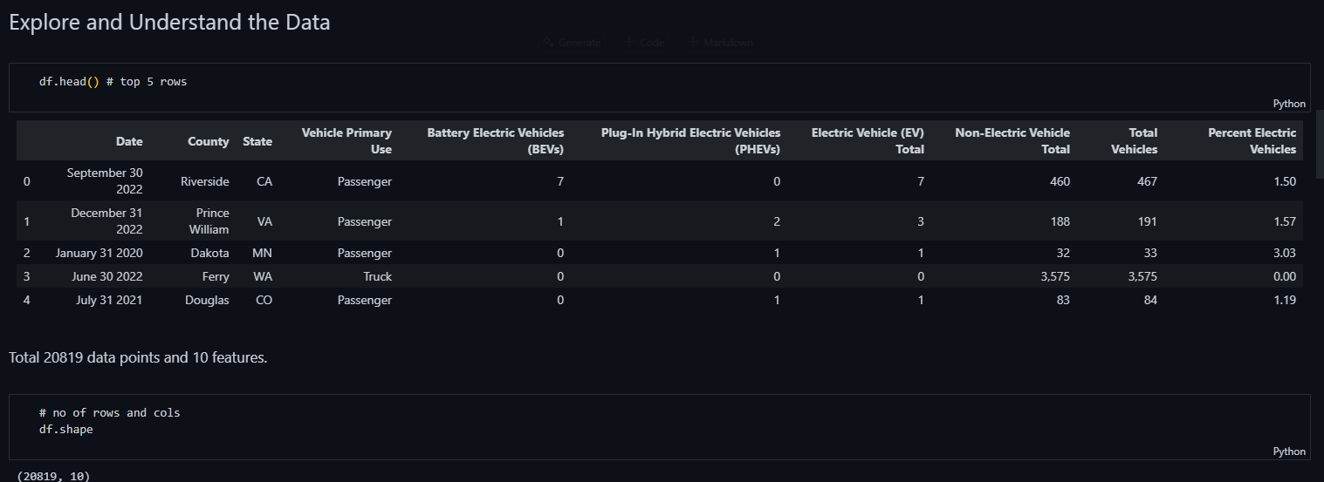
Screenshot of Output:

Slide 8
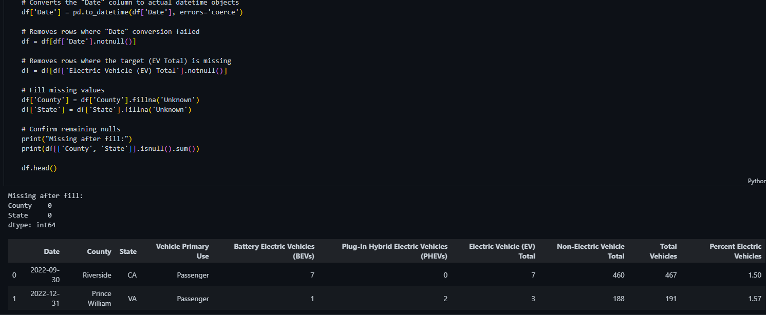
Screenshot of Output:

Slide 9
Conclusion:
PROJECT ACHIEVEMENTS:
• Successfully developed EV adoption forecasting model
• Achieved high prediction accuracy using Random Forest
• Processed and cleaned 20K+ vehicle registration records
• Identified key adoption patterns and regional trends
BUSINESS IMPACT:
• Enables data-driven infrastructure planning
• Reduces charging station deployment risks
• Supports sustainable transportation goals
• Optimizes resource allocation for urban planners
TECHNICAL LEARNINGS:
• Mastered time series forecasting techniques
• Applied advanced data preprocessing methods
• Implemented robust ML pipeline
• Gained expertise in transportation data analysis
FUTURE ENHANCEMENTS:
• Integration with real-time charging usage data
• Deep learning models for improved accuracy
• Mobile app for planners and policymakers
• Integration with smart city platforms
SUSTAINABILITY IMPACT:
This project directly supports UN SDG 11 (Sustainable Cities) and SDG 13 (Climate Action) by enabling better EV infrastructure planning, ultimately accelerating the transition to sustainable transportation.

